Slide 1


SAP UI5 & FIORI with OData TRAINING
Anubhav Oberoy & Shekhar Vedi
Day – 3

Slide 2

Agenda – Day 3
Working variables in JavaScript
Some Important point related to JavaScript
Methods to apply JS in HTML
Functions in JS
Synchronous and Asynchronous behavior in JS
Data Types in JS
Arrays and Object in JS

Slide 3
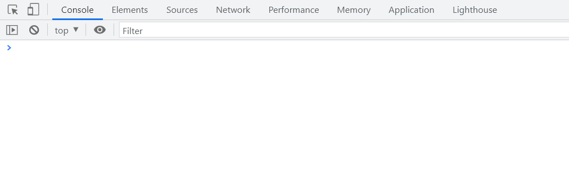
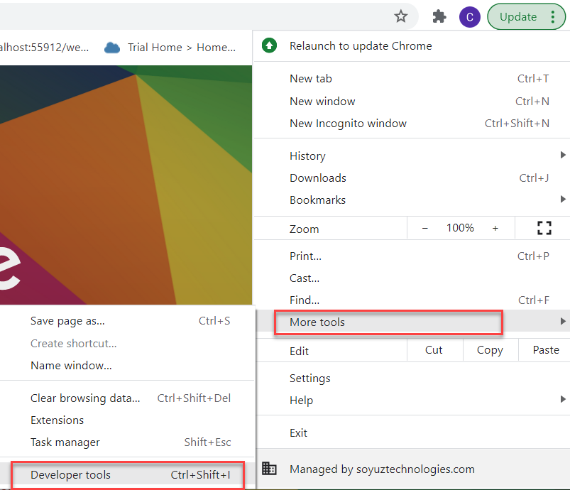
Creating the Variables in JS
In a programming language, variables are used to store data values.
JavaScript uses the keywords var, let and const to declare variables.
An equal sign is used to assign values to variables.
JavaScript variables are case sensitive.
Example: -
var x; var a = 10; let y; var b = ‘Hello World’;
How to access Console in the Browser.
We can access the console in the browser by pressing F12 on the keyboard.
On console we can execute the JavaScript commands, and we can also view the output over there.
We can also access the console form developer tools.

Slide 4

Exercise
Now we will see how to create variables in JS and what are the type of variables.
We will also perform some basic operations on the variables.
Exercise Code/Resources:-
- JSBasics

Slide 5
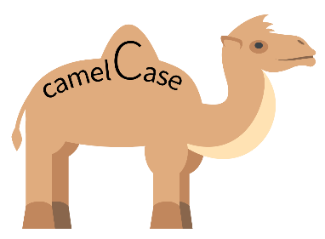
Some Important Point related to JavaScript
JS is case-sensitive (80% developers does case-sensitive errors)
Every statement in JS ends with semi-column
In JS = is an assignment operator, == and === are comparison operator, == compare only value and === compare data type also
We can declare variable in JS w/o any data type, based on the value assigned to the variable system auto determine the variable type, the keyword to declare variable is var.
JS Naming convention is camel case, the first letter of any word is small, next consecutive word’s first letter is caps.
Ex:-
iloveindia ➔ iLoveIndia
wearelearningJS ➔ weAreLearningJs
Methods to Apply JS in HTML
Inline JS – The script code is applied at html element level using events e.g., onclick, ondblclick, onhover, onkeypress. This is not recommended as its not reusable.
Internal JS – We write script code inside a script tag. We can use functions for that. There are 2 types of function. Which means it is reusable.
External JS – JS code is written in another file which has extension as .js. We will link it with our script tag. In the same way we linked CSS with link tag.

Slide 6
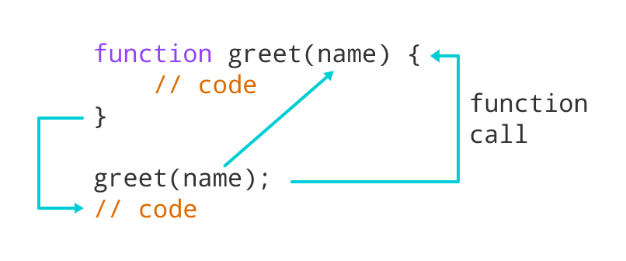
Function in JavaScript
Functions in JavaScript
A JavaScript function is a block of code designed to perform a particular task.
A JavaScript function is executed when "something" invokes it (calls it).
A JavaScript function is defined with the function keyword, followed by a name, followed by parentheses ().
The code to be executed, by the function, is placed inside curly brackets: {}
Function parameters are listed inside the parentheses () in the function definition.
Function arguments are the values received by the function when it is invoked.
Inside the function, the arguments (the parameters) behave as local variables.
Types of functions
Functions are of 2 types →
1. Anonymous function 2. Named Function
function(params) {
//code
}
function functionName(params) {
//code
}
JS also has 2 very powerful built-in/system variables which we can use out-of-box.
document = it is the object of DOM and can be used to access all the HTML elements on the page. The document object has so many reusable functions like getElementById, getElementsByClassName, getElementsByTagName
window = it is the object of our browser window

Slide 7
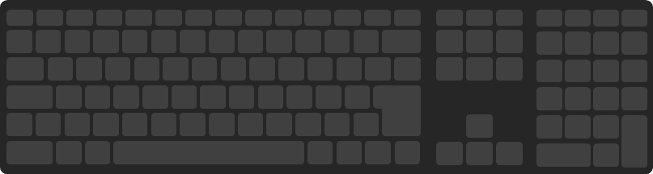
Exercise
Now we will see some example related to Inline, Internal and External JS
Design a login screen with login button. If user enter user and password SAME login user by changing DOM to login success. Else show an alert that username and password invalid.
Exercise Code/Resource:
JSBasic
mycode.js

Slide 8
Synchronous and Asynchronous Response
User
Screen
Server
Database
Save
Processing
Time
Request send to server
Request to Database
Synchronous Response
For all this time user
Remains blocked
Response form Database
Save
Request send to server
For all this time user
Remains blocked
Request to Database
Asynchronous Response
For all this time user
Is Not Blocked
Response from the server
Response form Database

Slide 9
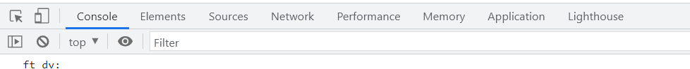
JavaScript Debugging Tools
Debugging is the process of detecting and removing of existing and potential errors (also called as 'bugs') in a software code that can cause it to behave unexpectedly or crash.
In order to debug JS code effectively, start the web app in a new tab/window, open F12 with option Sources tab. Set up the Break point by clicking on the line number.
Shortcuts for debugging are as below
Type | ABAP | JS
Step-in | F5 | F11
Step-out | F7 | Shift+F11
Go to next | F6 | F10
Continue (till Next BP) | F8 | F8
There are several tabs in the console, while working on the application we are mainly focused on Console, Elements, Source and Network Tab.
Console: It is the place where we run the JavaScript Code and Print the output for testing and Debugging
Elements: It shows the DOM of the current page open in browser.
Source: All the JavaScript code of the app or page will be visible here. We can also debug the code form here.
Network: We can see all the Network related calls made by the application in this section.

Slide 10
Data Types of JavaScript
Data types in JavaScript describe the different types or kinds of data that you will be working with and storing in variables. It's important that you learn each of these data types because otherwise data can get stored in an improper format which will result in issues in your code later.
JavaScript Data Types
Primitive
Non-Primitive/Reference
String
Array
Object
Number
Boolean
Undefined
Null
Symbol

Slide 11
Arrays and Objects in JS
Array: An Array is a collection of data and a data structure that is stored in a sequence of memory locations. One can access the elements of an array by calling the index number such as 0, 1, 2, 3, …, etc. The array can store data types like Integer, Float, String, and Boolean all the primitive data types can be stored in an array.
Object: An Object is a non-primitive, structured data type in JavaScript. Objects are same as variables in JavaScript, the only difference is that an object holds multiple values in terms of properties and methods.
Syntax for object
var oObjName = { “prop”: value,
“prop”: value,
“prop”: value }
Syntax for Array
var aItems = [item0, item1,….]
Ex:
var myArr = [1, 2, 3, 4, 5];
var myArr2 = [‘a’, ‘b’, ‘c’];
Example of an Object
{
//this is an EntitySet of type object (single)
"empStructure": {
"empNo": 100,
"empName": "Latika Roongta",
"salary": 9000,
"currency": "EUR"
}
}
Java Script Object Notation – JSON
You can validate json using https://jsonlint.com
Elements or properties
Entity set

Slide 12
Exercise
In this exercise we will create a JSON, and then will print the data in that json on the console on press of a button on the HTML page.
Exercise Code/Resource:
JSBasic
mycode.js

Slide 13

End of Day 3

Slide 14

Questions

Slide 15

Anubhav Oberoy

Slide 16


We’re committed to empower you to be
Most Desirable Resource
through powerful training solutions.
We build the workforce of the future.
250+
Corporate Clients
30,000+
Learners Trained
25000+
Learners Placed
FREE WEBINARS
Sign up for free webinars with industry experts every fortnight!
Enroll Now!
Contact us today!
https://anubhavtrainings.com/

Slide 17




More from AnubhavTrainings.com

Slide 18
Title
Content

